Slide 1

2022 K-SW Square Fall Midterm Presentation
Team. Chasing FOX
10/28/2022
Notes:
Hello. This is hyun one of Team Chasing Fox.
From now on, I will start K-SW Square Fall Midterm Presentation.

Slide 2







Team Introduction
“ Chasing FOX ”
Daye Kim
Kyunghee Univ.
Data Analysist
rlaek4793@khu.ac.kr
Hyun Roh
Kyunghee Univ.
Front-End Developer
yeshyun@khu.ac.kr
Juwon Baek
Handong Univ.
Data Analysist
21700340@handong.ac.kr
Jihu Yang
Handong Univ.
Back-End Developer
zihooy@handong.ac.kr
Heewon Jeong
Chungbuk Univ.
All-Rounder
jhjmo0719h@chungbuk.ac.kr
Bryanna Ruiz
Purdue Univ.
All-Round Helper
ruiz114@purdue.edu
Notes:
This is team Chasing Fox.
This is our team: Daye Kim, Juwon Baek, Heewon Jeong, Hyun Roh, Jihu Yang, and Bryanna.
We have four roles in our team, AI researcher, Front-end, and Back-end, All-rounder.

Slide 3
INDEX
Project Introduction
Previous Research
Data Explanation
Data Analysis
Result
Future Work
Challenges
Section 1
Section 2
Notes:
This is Index of this presentation.
Part is not that neccesary

Slide 4
Part 1
Project Introduction

Slide 5




Project Introduction
Navigation Application that recommends a safe route from the crimes
Team Chasing Fox
Application
Notes:
‘Rabbit’ is the name of our Application that we will develop
Like a rabbit, you can hop around the dangerous area using our App.
And we are team Chasing Fox that is chasing the rabbit.

Slide 6









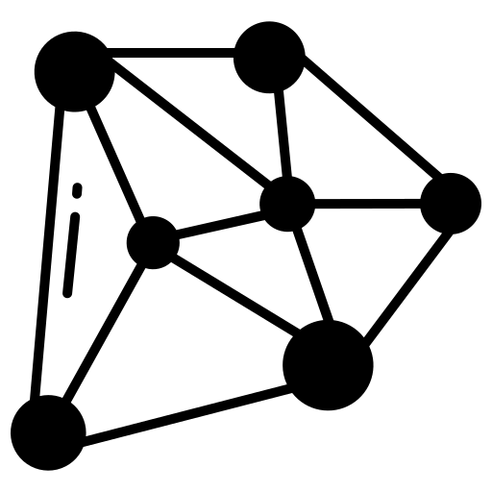
Project Introduction
Project Process
We are here!
Problem Definition
Previous Research
Data Collection
Data Analysis
Application Implementation
Algorithm Implementation
Safety Score Definition

Slide 7
Project Introduction
Problem Definition
Why?
Public Safety

Slide 8
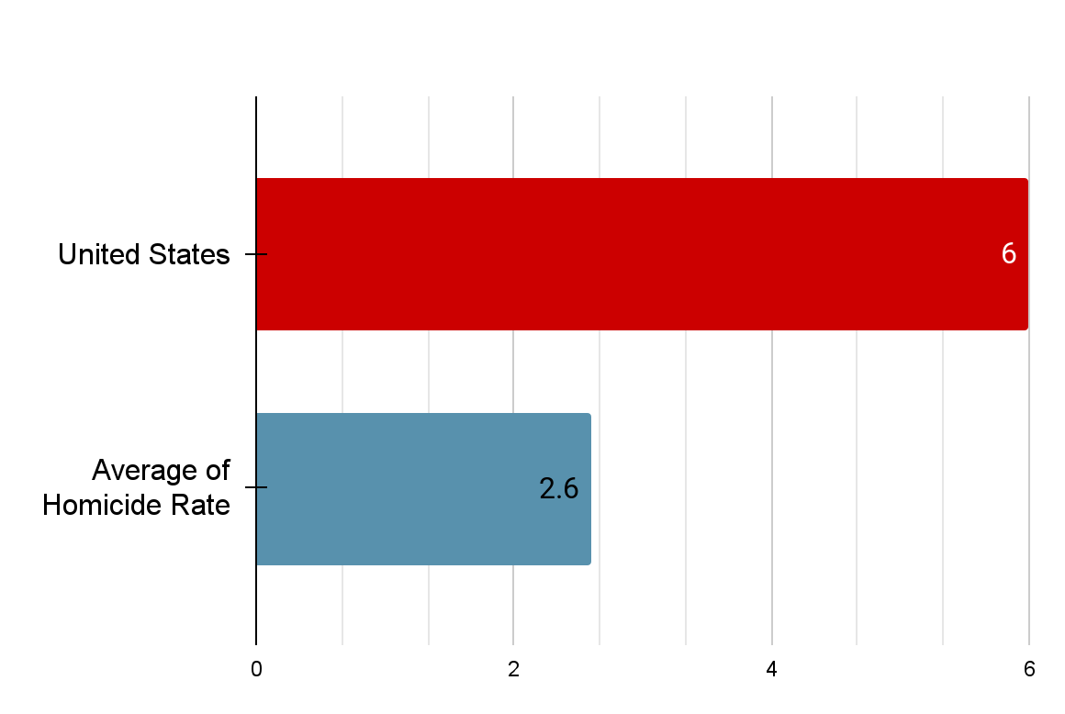
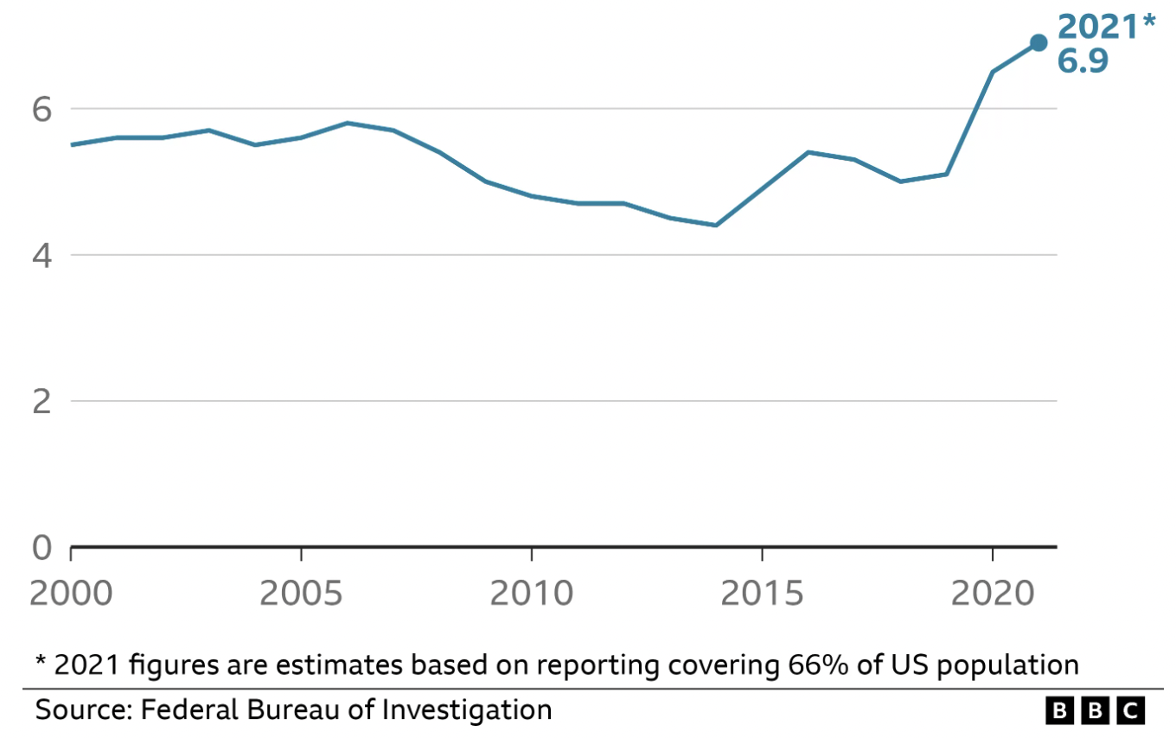
Project Introduction
Homicide Rate of OECD (per 100,000 Inhabitants)
The number of US murders (per 100,000 people)
The Homicide Rate of U.S. ranks 6 among 38 OECD countries
The number of Murders is increasing in the US
Notes:
Public safety is one of the most significant concerns in the United States since crime rates are higher than in other OECD countries.
According to the OECD Better-Life-Index, the homicide rate in the United States is higher than the average of the OECD countries.
Although the OECD countries had a downward trend in crime rates since 2010, the United States had an increase in crime rates. However, having a high crime rate in the United States does not mean it is dangerous in every division; for example, South Chicago accounts for 40 percent of Chicago’s total crime rate [3]. Therefore, it is essential to recommend safe routes to avoid dangerous regions.

Slide 9



Project Introduction
RABBIT
Only recommend the Shortest Route
Recommend the Safest Route
Notes:
Public safety is one of the most significant concerns in the United States since crime rates are higher than in other OECD countries.
According to the OECD Better-Life-Index, the homicide rate in the United States is higher than the average of the OECD countries.
Although the OECD countries had a downward trend in crime rates since 2010, the United States had an increase in crime rates. However, having a high crime rate in the United States does not mean it is dangerous in every division; for example, South Chicago accounts for 40 percent of Chicago’s total crime rate [3]. Therefore, it is essential to recommend safe routes to avoid dangerous regions.

Slide 10
Part 2
Previous Research
Notes:
3:30

Slide 11
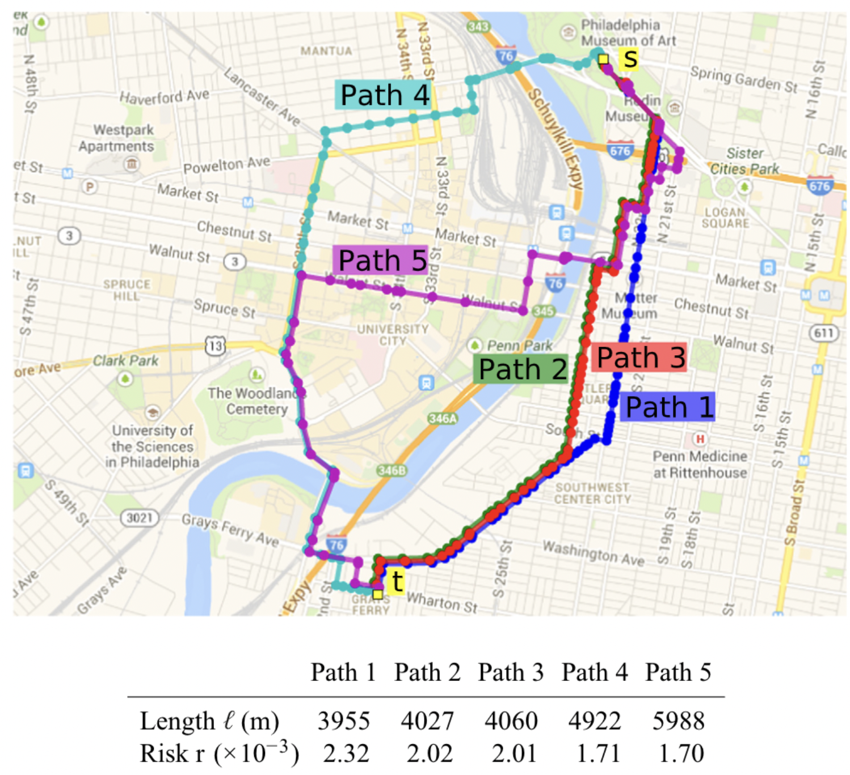
Previous Research
Urban navigation beyond shortest routes: The case of safe paths.
- Galburn et al. (2016)
Novelty of paper
Crime Density
KDE
Various Route
Limitation of paper
Non-Various Data
Reference.
E. Galbrun, K. Pelechrinis, and E. Terzi, “Urban navigation beyond shortest route: The case of safepaths,” Information Syst., vol. 57, pp. 160–171, Apr. 2016.
Notes:
KDE를 사용해서 위험도를 분석함.
KDE를 사용해서 범죄밀집도를 구함
도로의 위험돌르 분석함에 있어서 최대 위험 및 전체 위험을 고려한 알고리즘 2개를 고안했다,
이 범죄밀집도를 이용해서 최대 및 총 위험 점수를 구했다.
최대 위험 점수는 가장 큰 범죄 밀집도
도로의 위험도를 분석함에 있어서 최대의 위험도, 전체 위험도를 고려한 알고리즘 2개를 고안
그러나 이 연구는 다른 요인들은 고려하지 않고 범죄 자료만을 고려했다는 한계가 있다.
도로의 위험성을 계산하는 실시간 데이터를 고려하지 않았다.

Slide 12
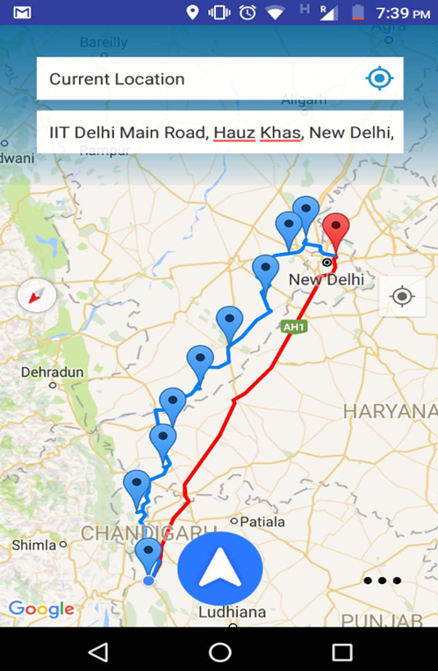
Previous Research
A crowd-sourced adaptive safe navigation
for smart cities
- Goel et al. (2017)
Novelty of paper
Consider various data
Limitation of paper
No data analysis about relation
Only one route
Reference.
Neeraj Goel, Rajat Sharma, N Nikhil, S D Mahanoor and Mukesh Saini
, “A Crowd-Sourced Adaptive Safe Navigation for Smart Cities”, 2017 IEEE International Symposium on Multimedia (ISM), vol. 57, pp. 160–171, Dec. 2017.

Slide 13
Previous Research
Limitation of other papers
Novelty of our paper
Non-Various Dataset
No data analysis about relation
Only one route
Considering the Crime Level
Various dataset
Verifying the Relation between Data
Recommending Various routes

Slide 14
Part 3
Data Explanation

Slide 15



Data Explanation
Collected Data
: Most of them were collected from the Chicago portal
Crime
Facility
Service Request/Report
Urban Factors
Notes:
시카고 범죄데이터에 대한 간략한 설명

Slide 16
Data Explanation
Collected Data (Crime)
From 2001 To 2022
31 Types of Crime Data
: Robbery / Homicide / GunShot Sex offense / Assult / Theft ······.
Location Information (longitude, latitude)
Notes:
시카고 범죄데이터에 대한 간략한 설명

Slide 17





Data Explanation
Collected Data (Urban Factor - Facility)
Fire Station
Library
Police Station
School
Family & Support Service Agency
Bus Stop
Notes:
사용된 시설 데이터에 대한 설명. 그냥 ~~~한 데이터들이 사용되었고, 각 데이터에는 시설의 위치들이 저장되어 있다.

Slide 18




Data Explanation
Collected Data (Urban Factor- Service Request/Report)
Abandoned Building
Graffiti Removal
Light out
GunShot Alert
Sanitation

Slide 19
Data Explanation
Crime
Facility
Service Request/Report
These datas could be related to the Crime Occurrence

Slide 20
Part 4
Data Analysis

Slide 21

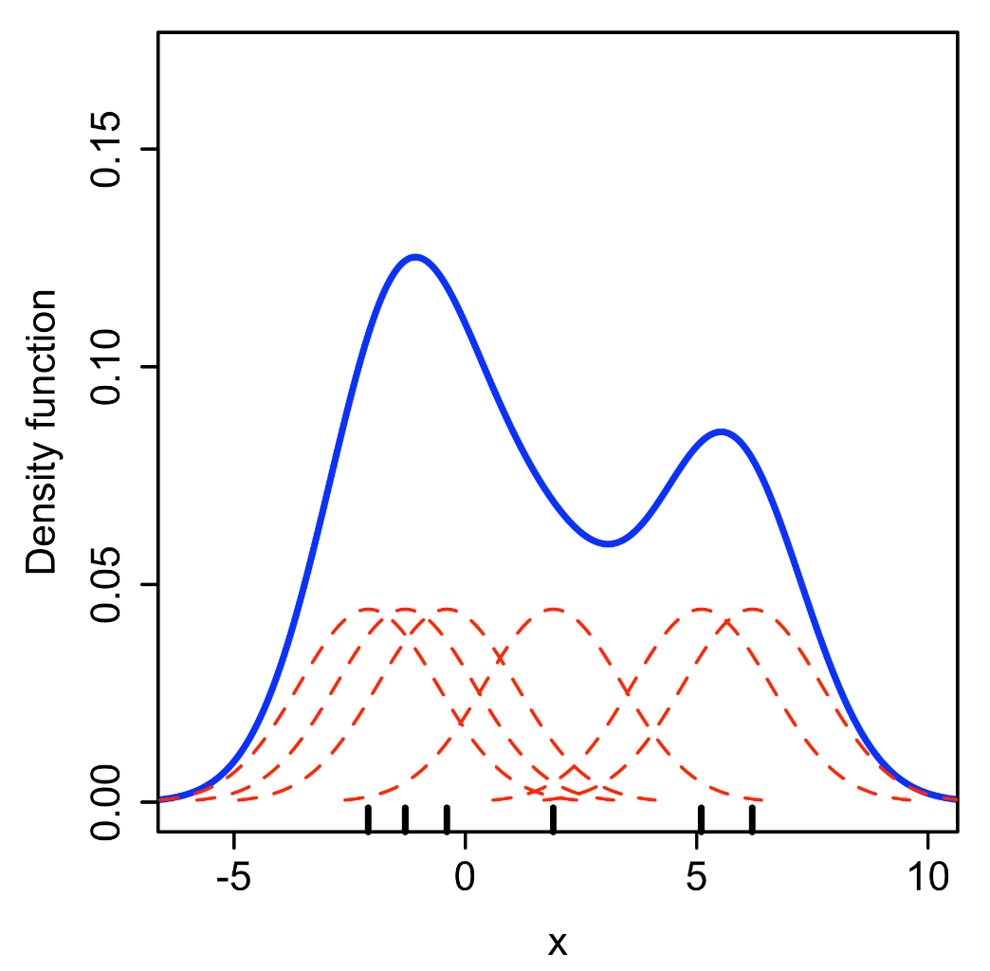

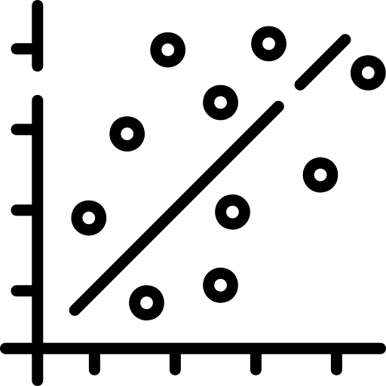

Data Analysis
Data Analysis Method
Data Preprocessing
KDE Application
Correlation
Density estimation using KDE
Population Density Consideration
Crime Data Extraction
Correlation Calculation
Facility & service request data
Density estimation using KDE
By Drleft at English Wikipedia, CC BY-SA 3.0, https://commons.wikimedia.org/w/index.php?curid=57332968
Notes:
다양한 방식을 시도했는데 그 중 하나의 방법을 소개하려고 한다.

Slide 22


Data Analysis
Data Preprocessing
Crime Data Extraction
Violent Crime
Weighted Crime

Slide 23
Data Analysis
Data Extraction - Violent Crime
Aggravated Assault/Battery
Criminal Sexual Assult
Homicide
Robbery
Violent Crime

Slide 24
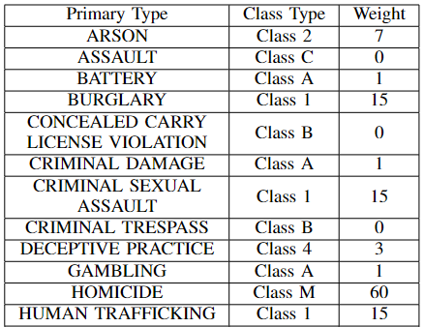
Data Analysis
Data Extraction - Weighted Crime
Weighted Crime
Notes:
범죄데이터를 구성하고 있는 데이터 포인트는 각각의 Class에 소속되어있으며 각 class type 별로 형량이 상이.
형량을 참고하여 가중치를 두었으며, 가중치에 해당하는 수 만큼 동일한 데이터포인트를 생성함.
가중치를 정의하기 위해서 일리노이 제너럴 어셈블리 웹사이트를 참조하였다.

Slide 25
Data Analysis
KDE Application
Kernel Density Estimation(KDE) ?
Kernel : Non-negative, symmetric function whose integration value for whole domain is 1.
Density Estimation: Estimating probability density function (PDF) of population from the sample data.
KDE: Estimate PDF of population from sample data using kernel function.
Wikipedia contributors. (2022, July 25). Kernel (statistics). In Wikipedia, The Free Encyclopedia. Retrieved 13:18, October 20, 2022, from https://en.wikipedia.org/w/index.php?title=Kernel_(statistics)&oldid=1100253771
Notes:
뺄까 고민중 글을 줄일 수 있으면 좋겠다? 아니면 나누는 것도 방법

Slide 26
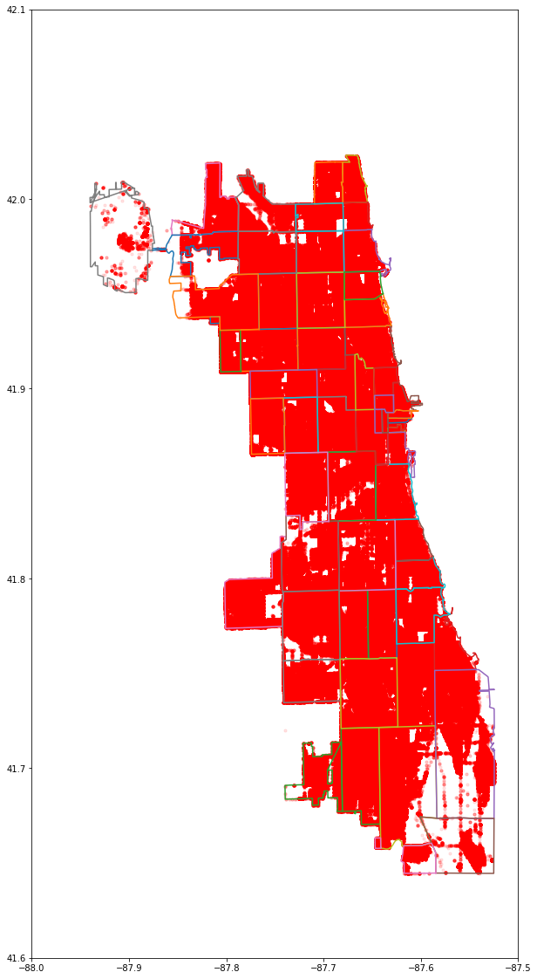
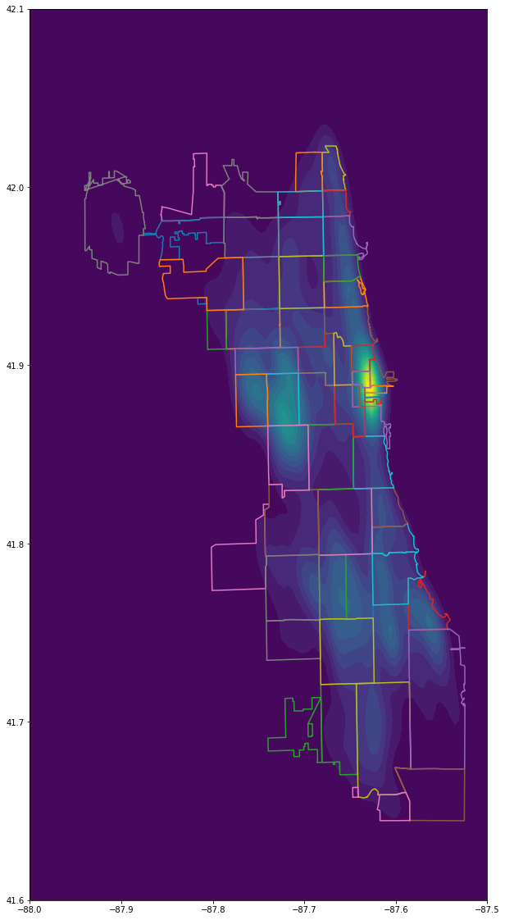
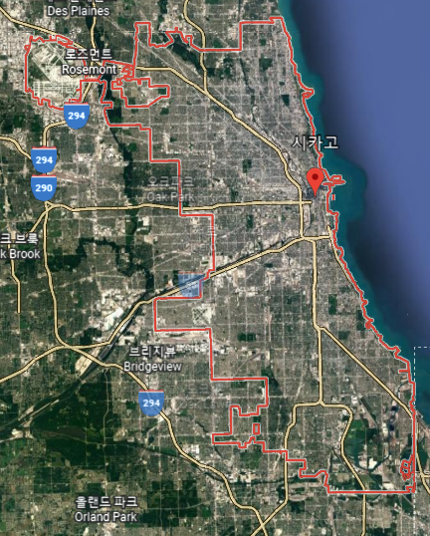
Data Analysis
KDE Application
Image of Chicago
Scatter plot of crime data (Not preprocessed)
KDE applied data (Not preprocessed)

Slide 27
Data Analysis
KDE Application - Population Density Consideration
Density of crime should be considered with population. (Galburn et al., 2016)
Equation below is applied to the value from the KDE

Slide 28
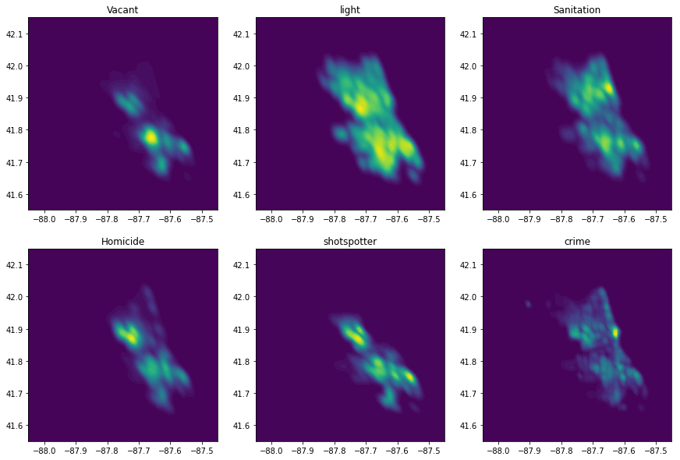
Data Analysis
KDE? - Facility/Service Request Data

Slide 29
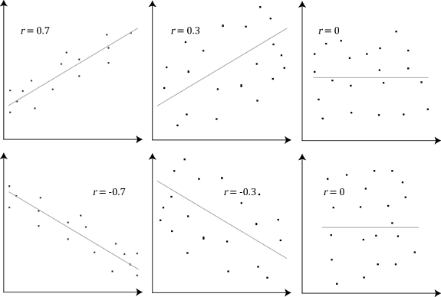
Data Analysis
Correlation Calculation
x axis : value of crime density
y axis : value of urban factor density
Wikipedia contributors. (2022, October 17). Correlation. In Wikipedia, The Free Encyclopedia. Retrieved 13:17, October 20, 2022, from https://en.wikipedia.org/w/index.php?title=Correlation&oldid=1116600032
Notes:
상관관계는 데이터간의 dependency를 확인하기 위해서 사용되는 기법 중 하나.
여기에서 3개의 그래프를 볼 수 있는데, 각각의 그래프에서 x축은 데이터셋 하나에 값, y축은 나머지 데이터셋 하나의 값을 의미한다.
우리 프로젝트에서는 x축이 범죄 밀집도일 것이고, y축은 각 urban factor의 value 값이 됩니다.
correlation을 계산해서 얻은 값이 1에 가까운 양수이면, 도시 요소의 density

Slide 30
Part 5
Result

Slide 31
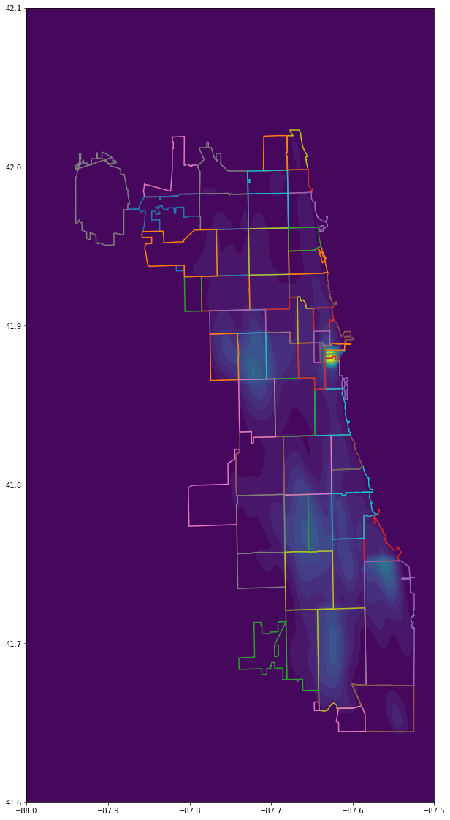
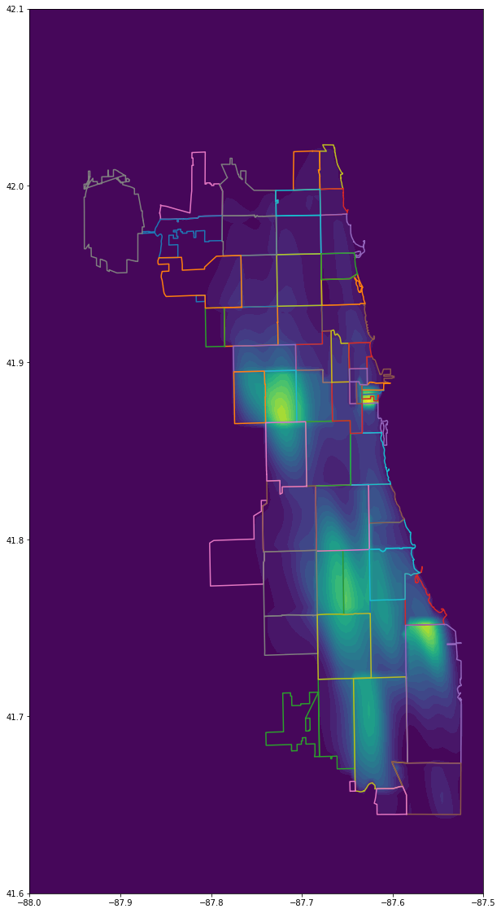
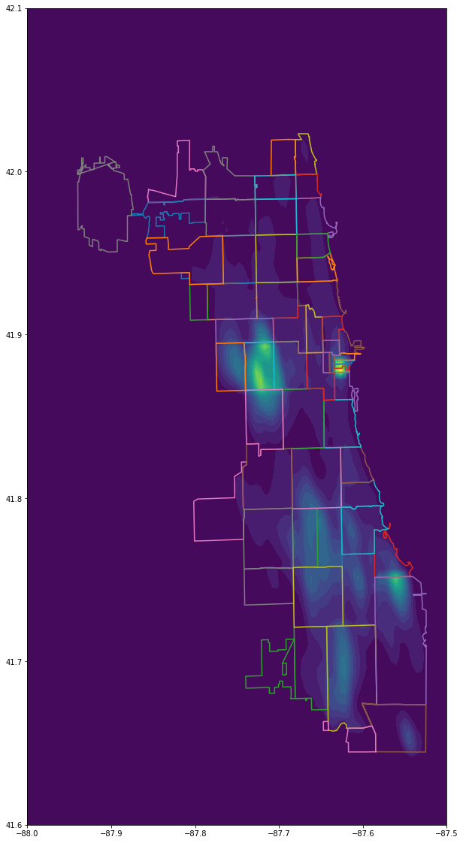
Result
Comparison with Non-preprocessed crime data
Crime Data Preprocessed only for Population
Violent Crime
Weighted Crime
Notes:
violent crime만 추출한 데이터로 KDE를 적용한 결과와 모든 범죄데이터에 대해서 weight를 적용한 데이터를 KDE를 적용한 결과를 비교했다.
완전히 동일하지는 않으나, 어느정도 유사성을 띄고 있는 것으로 보인다. 어떤 지역에서 범죄가 많이 발생하는지에 대해서 특정할 수 있었고, 모두 동일한 위치를 특정했다.

Slide 32
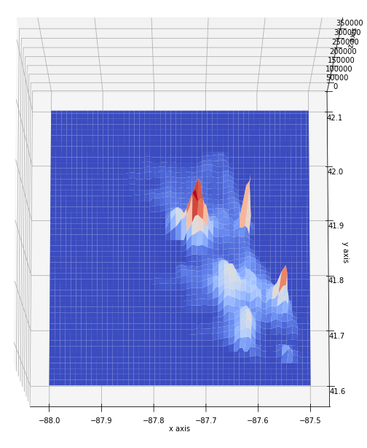
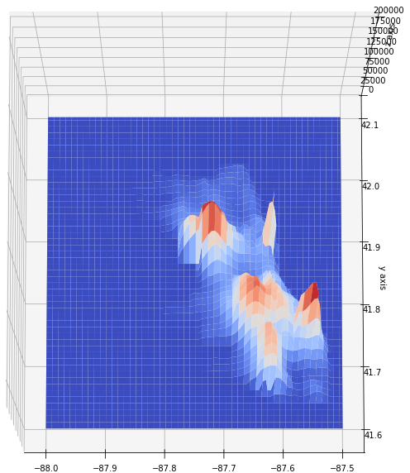
Result
3D Plot of Crime Density
Violent Crime Density
Weighted Crime Density
Notes:
violent crime만 추출한 데이터로 KDE를 적용한 결과와 모든 범죄데이터에 대해서 weight를 적용한 데이터를 KDE를 적용한 결과를 비교했다.
완전히 동일하지는 않으나, 어느정도 유사성을 띄고 있는 것으로 보인다. 어떤 지역에서 범죄가 많이 발생하는지에 대해서 특정할 수 있었고, 모두 동일한 위치를 특정했다.

Slide 33
Result
Correlation of Crime Density and Urban Factors
Column name | Correlation
Abandoned Building | 0.9
Shot Spotter Alert | 0.89
Light Out Report | 0.8
Sanitation Service Sequest | 0.78
Public School | 0.764
Family Support Agency | 0.761
Bus Station | 0.71
Police Station | 0.681
Library | 0.677
Fire Station | 0.675
Graffiti | 0.27
Column name | Correlation
Shot Spotter Alert | 0.84
Abandoned Building | 0.77
Light Out Report | 0.73
Family Support Agency | 0.712
Sanitation Service Request | 0.705
Public School | 0.69
Bus Station | 0.65
Library | 0.607
Fire Station | 0.606
Police Station | 0.6
Graffiti Removal Request | 0.27
Correlation with Violent Crime
Correlation with Weighted Crime
Notes:
상관관계 계수에서 차이가 있긴 하지만, 영향을 주는 요소들의 순위가 유사했다.
뭔가 정보가 많은 느낌? 주목해야 할 부분에 포인트 주면 좋을 듯

Slide 34
Part 6
Future Work

Slide 35
Future Work
What will we do is..
We are here!
Problem Definition
Previous Research
Data Collection
Data Analysis
Application Implementation
Algorithm Implementation
Safety Score Definition

Slide 36
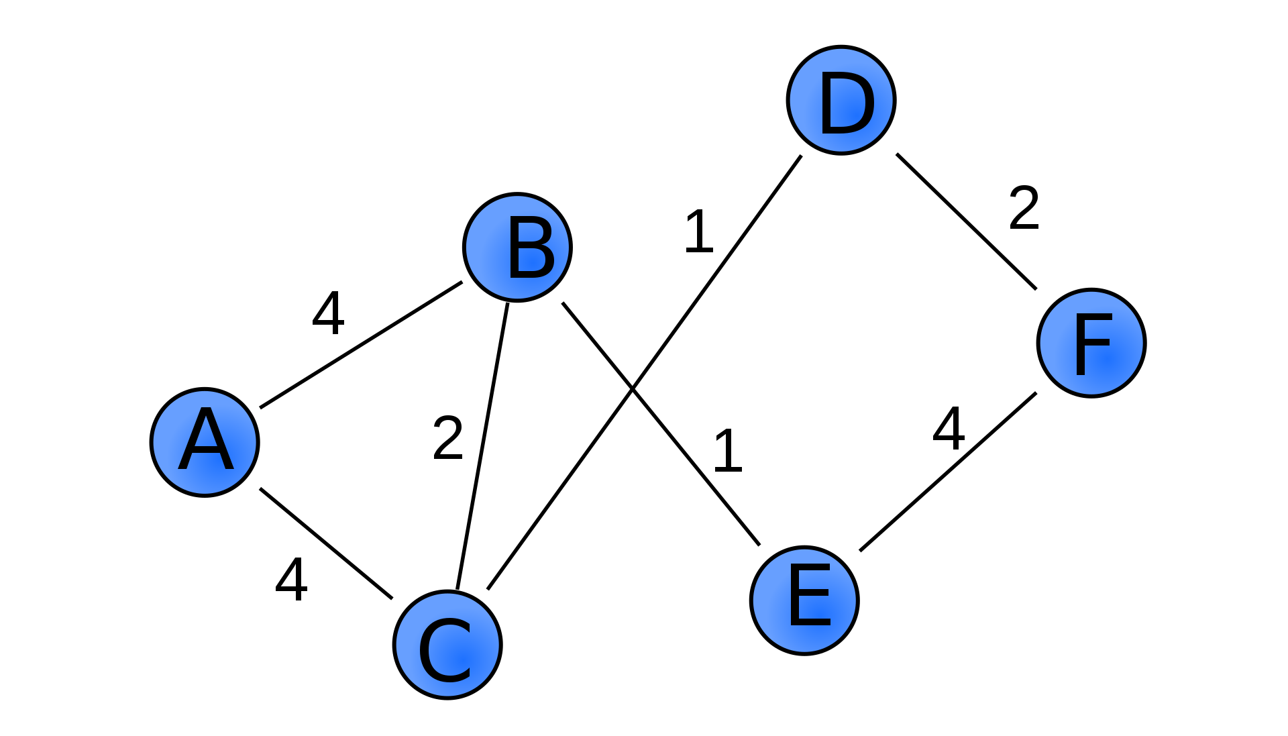
Future Work
Score Definition & Algorithm Implementation
Safety Score Definition
Weighted graph

Slide 37
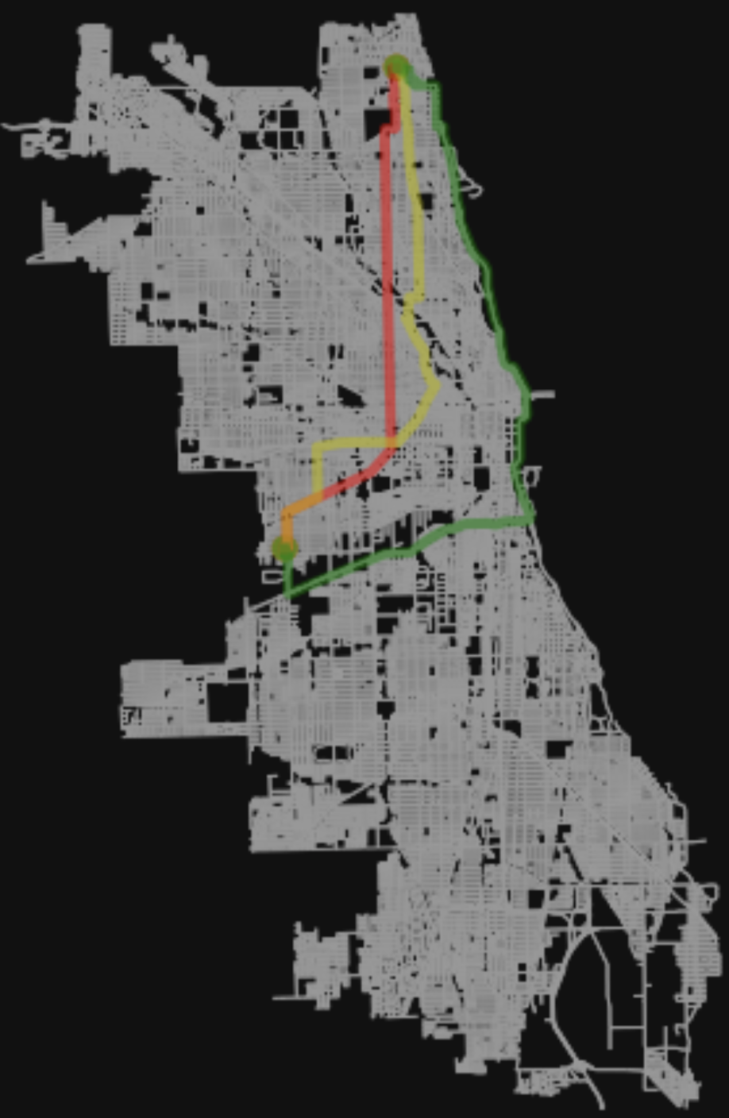
Future Work
By considering the weight of the edge, find the shortest/fastest/safest path
Shortest Path
Fastest Path
Safest Path

Slide 38

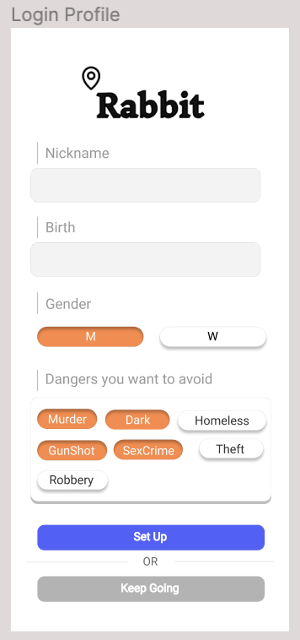
Future Work
Application Example
Nickname
Birth
Gender
Dangers you want to avoid
Keep Going (Not mandatory)
Notes:
사용자의 프로필을 토대로 경로를 추천해주는 시스템.
처음 어플을 켤 때 사용자는 프로필을 설정할 수 있다.
it is not mandatory to set up profile
로그인 기능은 구현하지 않고, 리액트 네이티브의 Local Storage를 이용해 프로필 정보를 저장한다. 사용자가 Cache or Data를 삭제하지않는 이상
프로필 정보는 유지된다.
닉네임, 생년월일, 성별, 피하고자 하는 범죄 유형을 선택한다.
예를들어 21살 여성이 피하고자 하는 범죄로 Murder를 택하면
Murder 범죄율이 낮은 곳을 추천해준다.
또한 21살 여성은 상대적으로 성범죄 위험에 노출될 확률이 높기에
성범죄 범죄율이 낮은 지역도 자동으로 같이 추천해준다. (제외)
Q&A. 프로필 설정을 안한사람은 어느 정보를 토대로 경로를 추천해주는지?

Slide 39
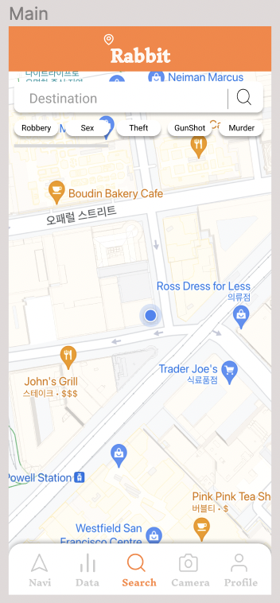
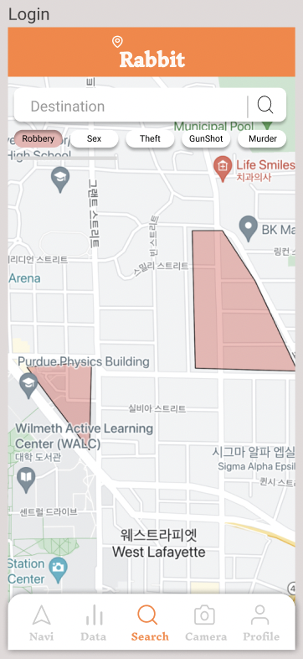
Future Work
Application Example
Crime
Polygon
Click!
Robbery
Polygon
Current Location
Notes:
메인페이지 화면

Slide 40
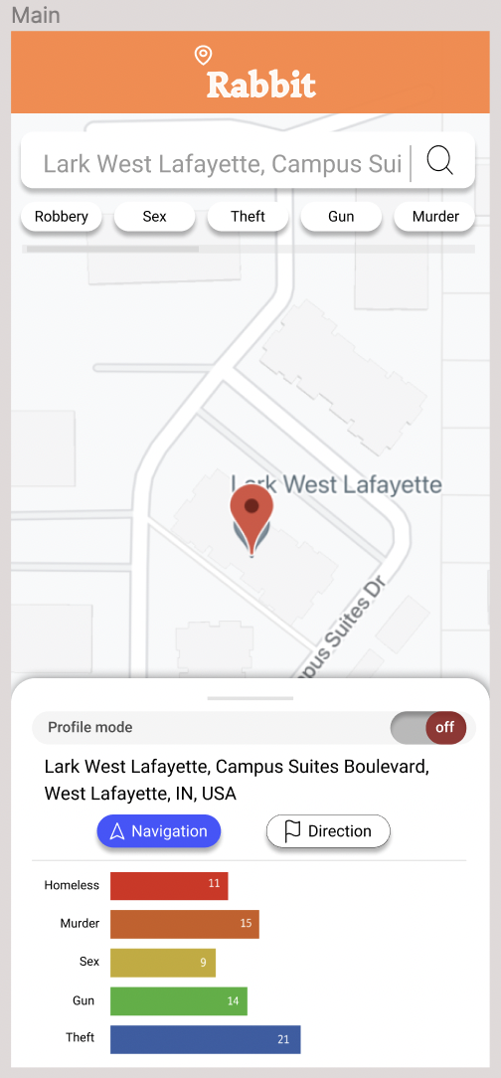
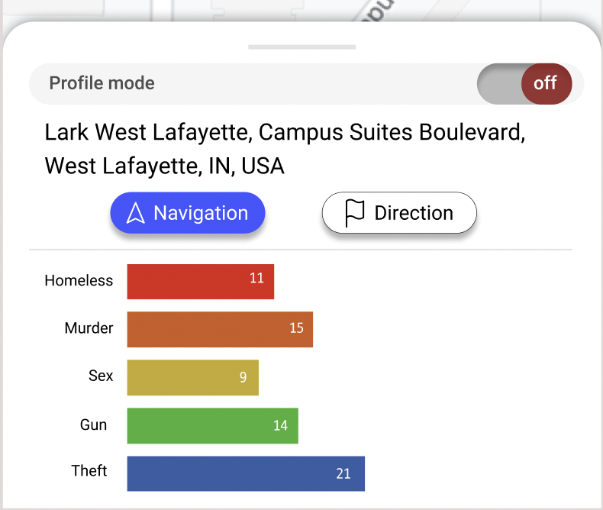
Future Work
Application Example
Profile Mode
Navigation / Direction
Crime Data Statistics
Notes:
검색 후 화면ㄴ

Slide 41
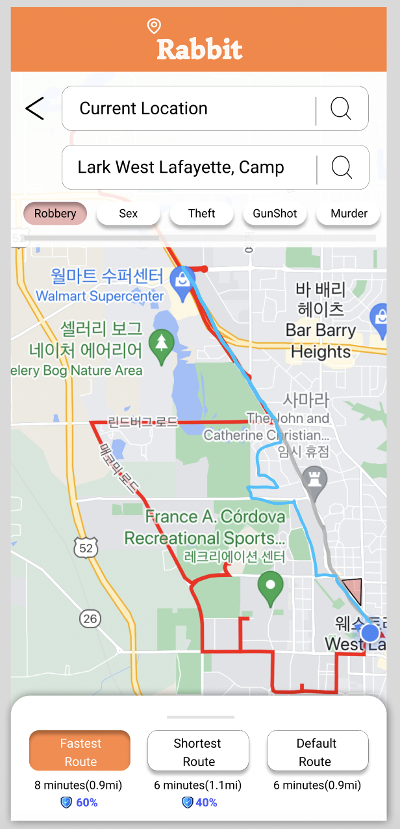
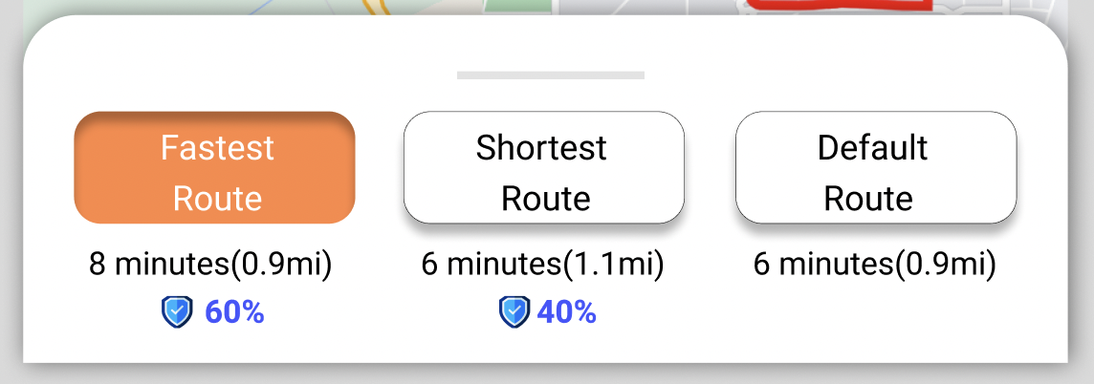
Future Work
Application Example
This suggests three paths.
: Shortest/Minimum Time/Default
The user selects a path in consideration of the Distance/Duration/Safety Level
Notes:
경로(Direction)클릭 화면

Slide 42
Part 7
Challenges

Slide 43
Challenges
Consider the population - Is it possible to apply this equation to the KDE result value that is the probability after integration? - Should we have to consider population density at the whole facility/service request data?
Notes:
이것도 정보가 조금 많아서 간단하게 표현 가능한지?

Slide 44
Reference
[1] J. Horton. ”US crime: Is America seeing a surge in violence?”. BBC. https://www.bbc.com/news/57581270 (accessed Sep. 28)
[2] Galbrun, E., Pelechrinis, K., & Terzi, E. (2016). Urban navigation beyond shortest route: The case of safe paths. Information Systems, 57, 160-171.
[3] Goel, N., Sharma, R., Nikhil, N., Mahanoor, S. D., & Saini, M. (2017, December). A crowd-sourced adaptive safe navigation for smart cities. In 2017 IEEE International Symposium on Multimedia (ISM) (pp. 382-387). IEEE.
[4] Crimes - Map, Chicago Data Portal, Sep 15, 2011. [Online]. Available: https://data.cityofchicago.org/Public-Safety/Crimes-Map/dfnk-7re6
[5] CTA Bus Stops, Chicago Data Portal, Feb 28, 2017. [Online]. Available: https://data.cityofchicago.org/Transportation/CTA-Bus-Stops/hvnx-qtky
[6] Police Stations, Chicago Data Portal, June 10, 2016. [Online]. Available: https://data.cityofchicago.org/Public-Safety/Police-Stations/z8bn-74gv
[7] Fire Stations, Chicago Data Portal, Apr 18, 2019. [Online]. Available: https://data.cityofchicago.org/Public-Safety/Fire-Stations/28km-gtjn
[8] Libraries - Locations, Contact Information and Usual hours of Operation, Chicago Data Portal, Oct 28, 2021. [Online]. Available: https://data.cityofchicago.org/Education/Libraries-Locations-Contact-Information-and-Usual-/x8fc-8rcq

Slide 45
Reference
[9] Chicago Public Schools - School Locations SY2021 - Map, Chicago Data Portal, Jan 10, 2022. [Online]. Available: https://data.cityofchicago.org/Education/Chicago-Public-Schools-School-Locations-SY2021-Map/9ybt-s3ms
[10] Family and Support Services Delegate Agencies, Chicago Data Portal, Oct, 7. 2015. [Online]. Available: https://data.cityofchicago.org/Health-Human-Services/Family-and-Support-Services-Delegate-Agencies/jmw7-ijg5
[11] 311 service requests - vacant and abandoned buildings reported - historical, Chicago Data Portal, Mar, 7. 2019. [Online]. Available: https://data.cityofchicago.org/Service-Requests/311-Service-Requests-Vacant-and-Abandoned-Building/7nii-7srd/data
[12] 311 Service Requests - Street Lights - All Out - No Duplicates, Chicago Data Portal, Apr, 17. 2019. [Online]. Available: https://data.cityofchicago.org/Service-Requests/311-Service-Requests-Street-Lights-All-Out No-Dupl/756k-itxx
[13] 311 Service Requests – Sanitation Code Complaints - Historical, Chicago Data Portal, Mar 7, 2019. [Online]. Available: https://data.cityofchicago.org/Service-Requests/311-Service-Requests-Sanitation-Code-Complaints-Hi/me59-5fac
[14] 311 Service Requests - Graffiti Removal - Historical, Chicago Data Portal, Mar 7, 2019. [Online].
Available: https://data.cityofchicago.org/Service-Requests/311-Service-Requests-Graffiti-Removal-Historical/hec5-y4x5
[15] Violence Reduction - Shotspotter Alerts, Chicago Data Portal, Sep 15, 2022. [Online]. Available:
https://data.cityofchicago.org/Public-Safety/Violence-Reduction-Shotspotter-Alerts/3h7q-7mdb
[16] Illinois General Assembly - Legislation. (n.d.). Retrieved October 16, 2022, from
https://www.ilga.gov/legislation/ilcs/ilcs2.asp?ChapterID=53

Slide 46
Q&A

Slide 47
Thank You
Hyun Roh
Daye Kim
Presenter
Q&A Session
Kyunghee Univ.
Kyunghee Univ.
yeshyun@khu.ac.kr
rlaek4793@khu.ac.kr
Juwon Baek
Jihu Yang
Presenter
Q&A Session
Handong Global Univ.
Handong Global Univ.
21700340@handong.ac.kr
zihooy@handong.ac.kr
Heewon Jeong
Q&A Session
Chungbuk Univ.
jhjmo0719h@chungbuk.ac.kr

